Slide 1
Machine Learning & Deep Learning
Dagon University
Department of Computer Studies
Second Year Project
Group - 3
Proudly presented by
Thant Yarzar Hein (2CS – 44)
Khant Zaw Hein (2CS – 26)
Wai Yan Htun (2CS – 11)
Myat Ko Ko (2CS – 27)
Supervised by
Dr. Yi Mon Win

Slide 2
Topics covered in this presentation
Introduction to Machine Learning
Basics Features and Labels
Machine Learning Techniques
Use Cases
Deep Learning

Slide 3
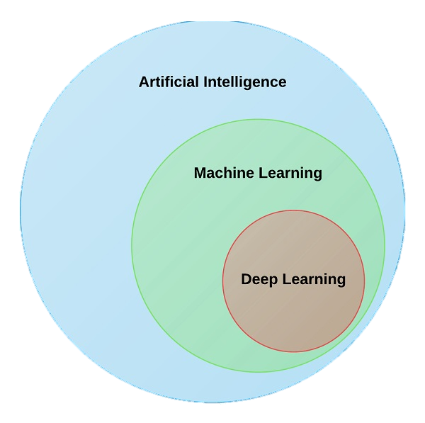
Introduction to Machine Learning
Sub-field of Artificial Intelligence (AI)
Ability to learn something without being explicitly programmed.
There are lots of different ways (algorithms) that machines can learn
Algorithms can be grouped into Supervised ,Unsupervised and Reinforcement algorithms.

Slide 4
When we use machine learning
For example, if we want to identify a dog type by a computer program, we can’t traditionally define the rule by “IF” conditions because even the dog type is same, they don’t have exact same height, colors etc..
This is when the machine learning comes in.

Slide 5
Overview Definition of Machine Learning Algorithms
“
A computer program is said to learn from experience E with respect to some class of tasks T and performance measure P if its performance at tasks in T, as measured by P, improves with experience E”
T
E
P
Tom M. Mitchell
Author of Machine Learning Book

Slide 6
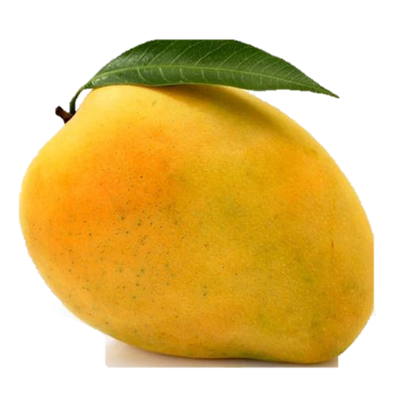
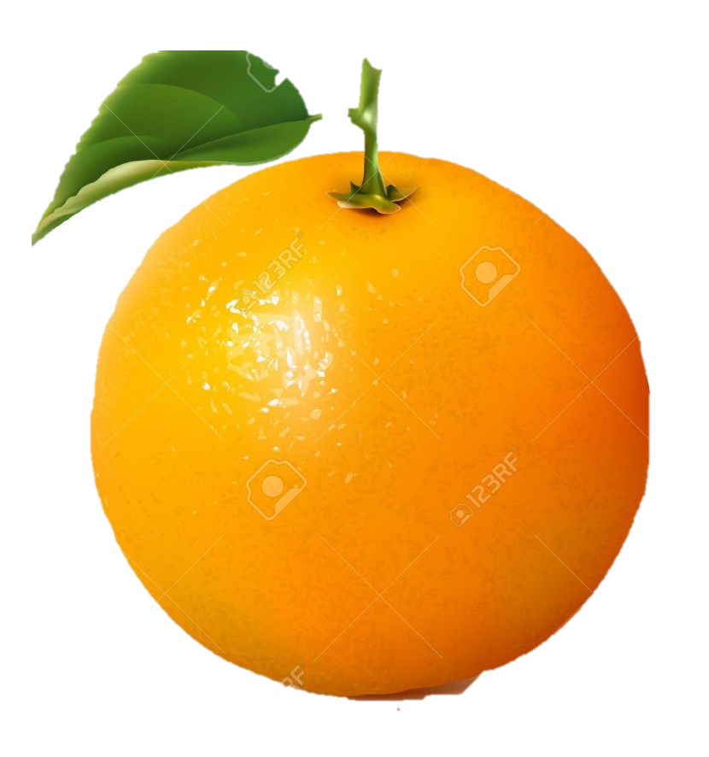

Features and Labels in M.L
Label : Orange
Label : Apple
Label : Mango
Features:
Color : Orange
Type : Fruit
Shape: Rounded
Texture : Bumpy
Features:
Color : Red
Type : Fruit
Shape: Rounded
Texture : Smooth
Features:
Color : Yellowish
Type : Fruit
Shape: Oval-shaped
Texture : Smooth

Slide 7

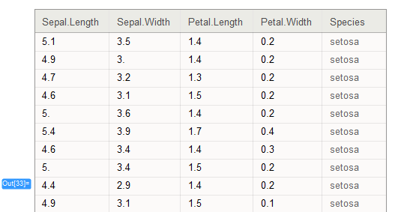

Data Types
Structured Data | Unstructured Data
Images
Audio waves
I’m a chaw lay
Text

Slide 8

How Machine learning works
Learn from examples and experiences.
Data Gathering
Data Cleaning
Train Data
Train Model
Evaluate Model
Deploy Model
Adjust Model Parameters

Slide 9
Traditional Programming vs M.L Based System
Traditional Programming
Rules
Answer
Data
Machine Learning System
Data
Rules
Answer

Slide 10
Types of Machine Learning
Reinforcement Learning
Machine Learning
Supervised Learning
Unsupervised Learning

Slide 11
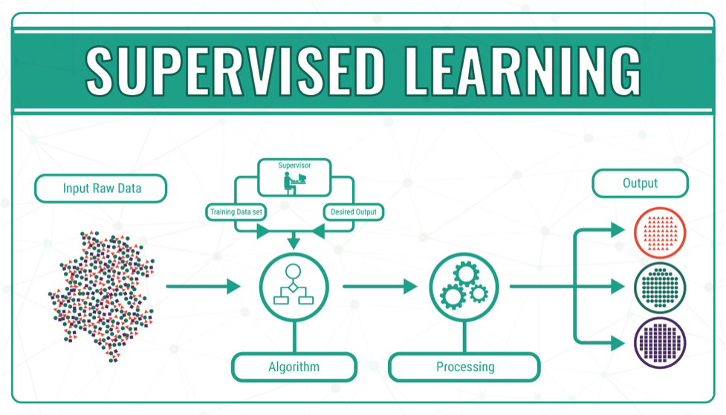
1. Supervised Learning
In Supervised Learning, Algorithms are trained based on labelled examples.

Slide 12
Divisions of Supervised Learning
Supervised Learning
Regression
Classification

Slide 13
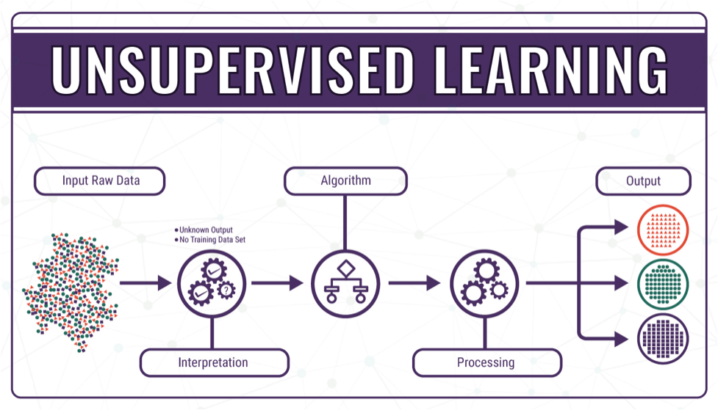
2. Unsupervised Learning
Algorithms operate on unlabelled examples, i.e., input where the desired output is unknown.

Slide 14
K-mean clustering

Slide 15
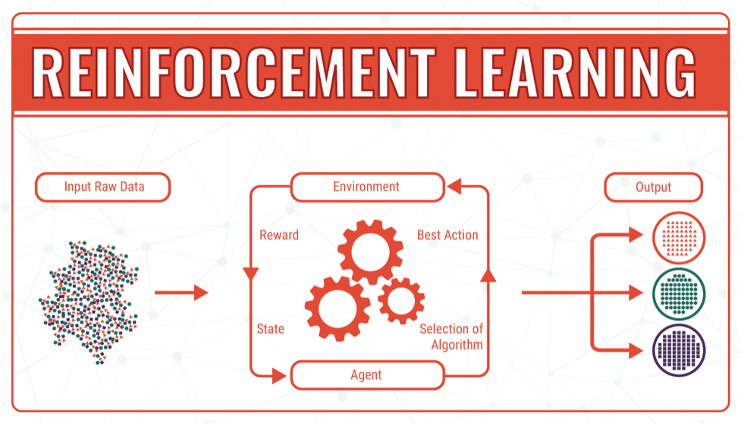
3. Reinforcement Learning
Reinforcement Learning is concerned with how intelligent agents ought to act in an environment to maximize some notion of reward from sequence of actions.

Slide 16
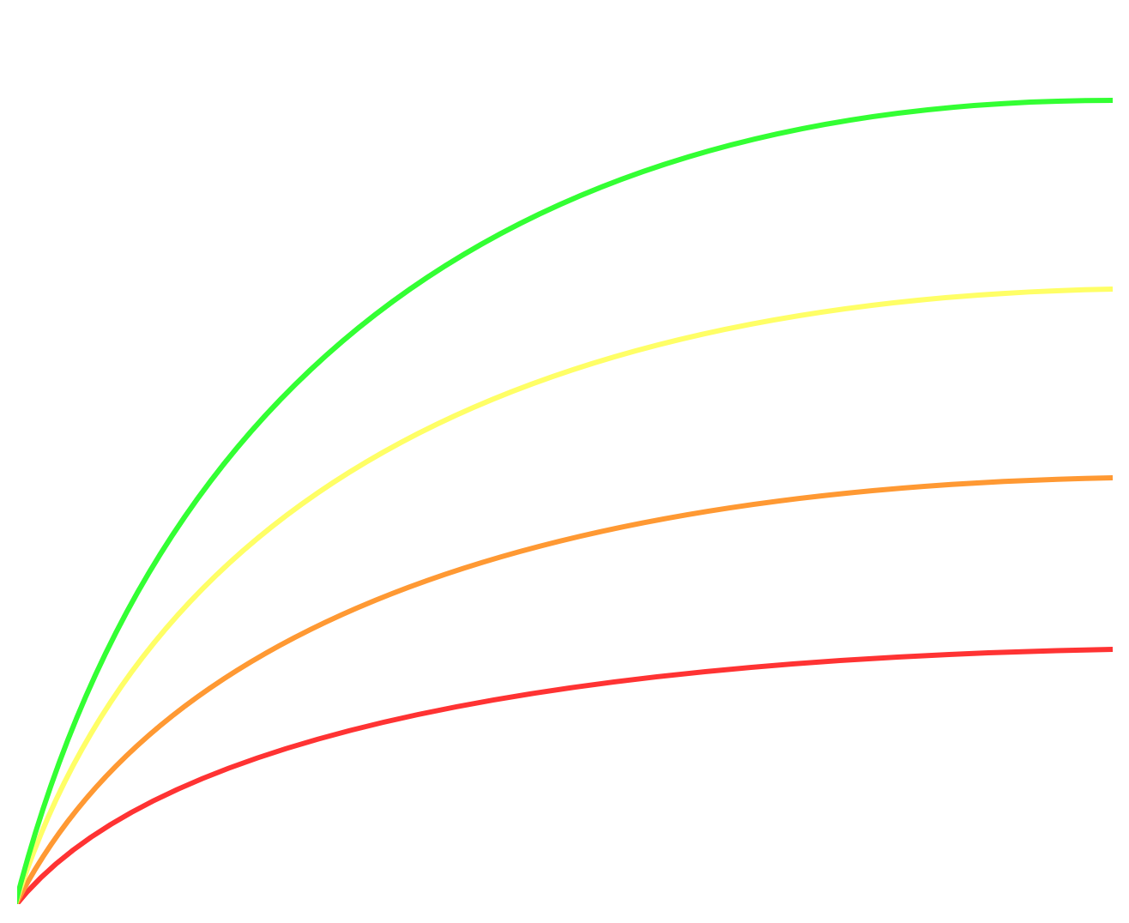
Scale drives deep learning progress
Large NN
Medium NN
Performance
Small NN
Traditional ML algorithms
Amount of data

Slide 17

Deep Learning

Slide 18

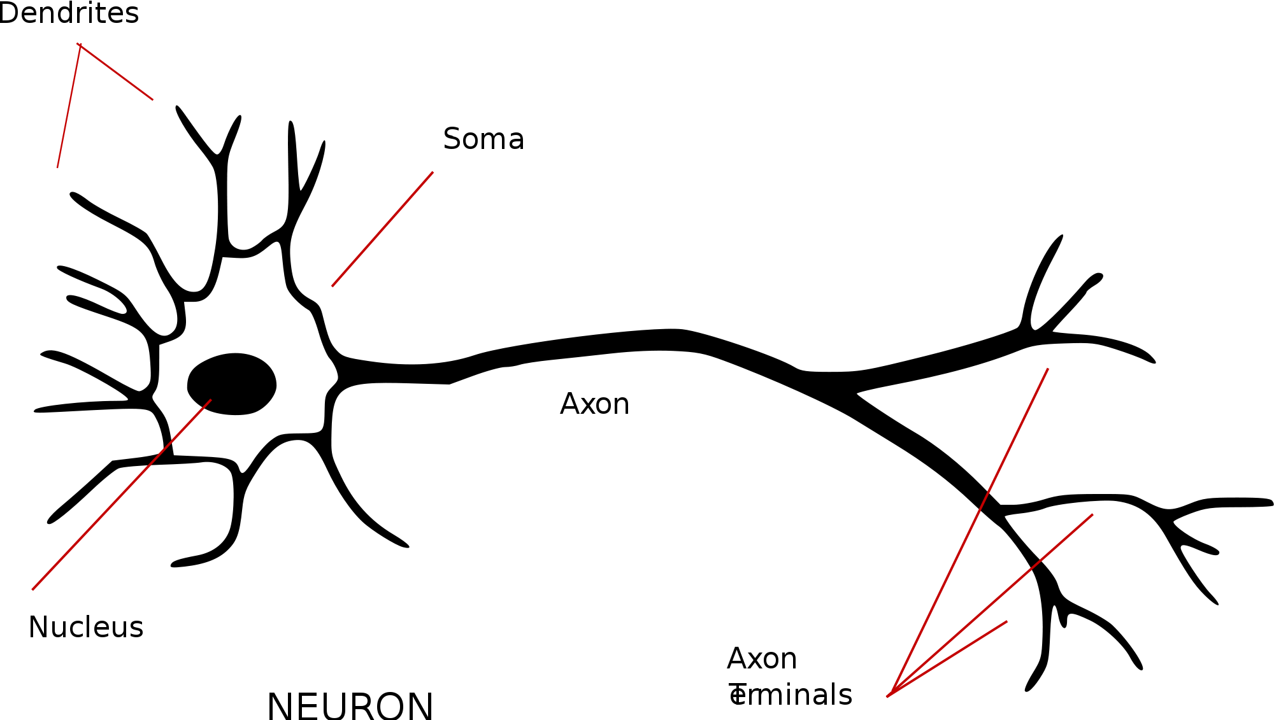

Perceptron

Slide 20
Use Cases
Face Recognition - Google Photos
Recommendation System - YouTube, Amazon, Spotify
Fraud detection : Payment System Providers i.e. Visa, MasterCard, PayPal, MPU
False News Detection – Facebook, Twitter
Online Advertising - Google AdSense, Facebook Ads
Photo Processing in Modern Phones i.e. Samsung Scene Optimizer, Huawei Camera AI,.. etc.

